Slide 1

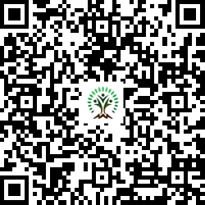


IONIQ Forest
Grid – G Zones 1 -10

Slide 2
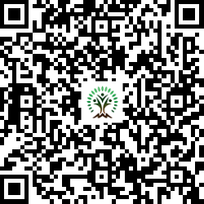
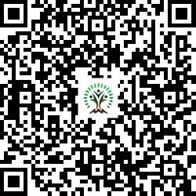
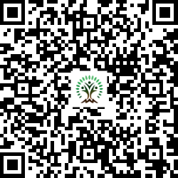
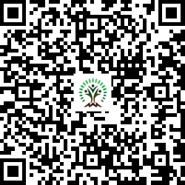
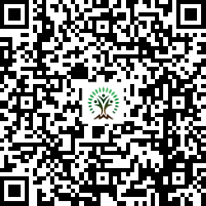
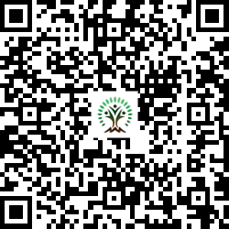
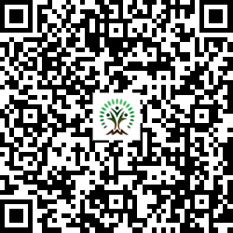
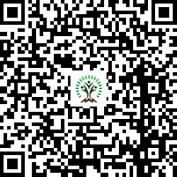
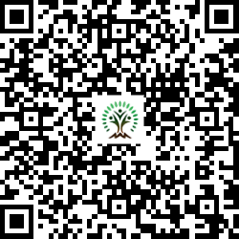
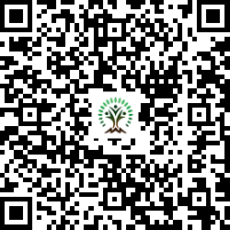
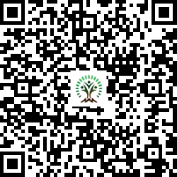
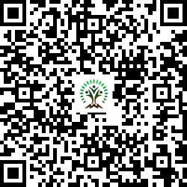
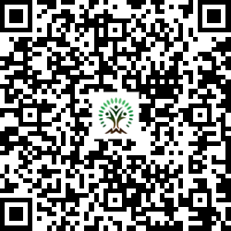
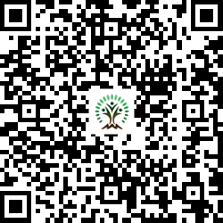
Sr. No. | Scientific Name | Common Name | QR Code
1 | Aegle marmelos | Wood Apple
2 | Alstonia scholaris | Blackboard Tree
3 | Anacardium occidentale | Cashew
4 | Azadirachta indica | Neem Tree
5 | Bauhinia variegata | Kachnar, Orchid Tree
6 | Butea monosperma | Flame of the Forest
7 | Cassia fistula | Golden shower tree
Sr. No. | Scientific Name | Common Name | QR Code
8 | Dalbergia sissoo | Indian rosewood
9 | Holarrhena pubescens | Ivory tree
10 | Lagerstroemia speciosa | Pride of India
11 | Limonia acidissima | Wood Apple
12 | Madhuca indica | Indian Butter Tree
13 | Melia dubia | Malabar Neem
14 | Neolamarckia cadamba | Burrflower tree

Slide 3
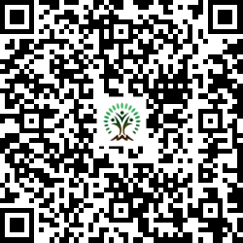
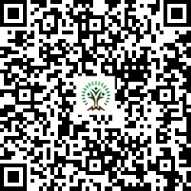
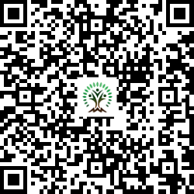
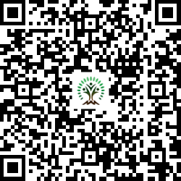
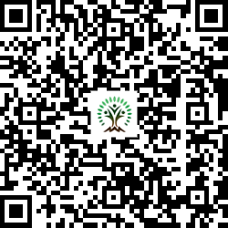
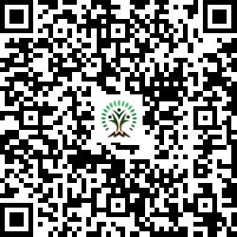
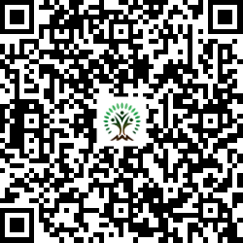
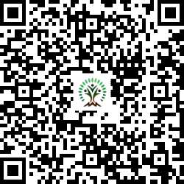
Sr. No. | Scientific Name | Common Name | QR Code
15 | Phyllanthus emblica | Indian gooseberry
16 | Pongamia pinnata | Indian Beech Tree
17 | Psidium guajava | Guava
18 | Putranjiva roxburghii | Lucky Bean Tree
19 | Syzygium cumini | Java plum, Jamun
20 | Tamarindus indica L. | Tamarind
21 | Terminalia arjuna | White Murdah
Sr. No. | Scientific Name | Common Name | QR Code
22 | Toona ciliata | Indian mahogany

